Slide 1



Class of 2023
Freshman advisement

Slide 2
Who Is Your School Counselor?
A-Ch: Laura Clary
Ci-G: Judy Rangel
H-K: Donna Dunham
L-N: Erica Watford
O-Sl: Tina Harwood
Sm-Z: Lisa Fay
Notes:
Please insert department information on this slide.

Slide 3
Creating the
Igp
Complete Individual Graduation Plan (IGP) in Naviance.
Helpful Resources: Academic Planning Guide

Slide 4
Graduation Requirements
Subjects | Diploma
English | 4 units of English Language Arts required, including 1 unit of 9th Grade Literature/Composition and 1 unit of American Literature
Mathematics | 4 units of Mathematics required
Science | 4 units of Science required, including 1 unit of Biology; 1 unit of Physical Science or Physics; 1 unit of Chemistry, Earth Science, Environmental Science, or an AP Science; and 1 additional unit of science
Social Studies | 3 units of Social Studies required, including 1 unit of World History, 1 unit of United States History, .5 unit of American Government and .5 unit of Economics
Health & Physical Education | .5 unit of Health and .5 unit of Personal Fitness Required
Career Technical Education and/or World Language and/or Fine Arts | A total of 3 units are required from Career Technical Education, World Language, and/or Fine Arts. Students planning to enter or transfer into a University System of Georgia institution or other post-secondary institution must take 2 units of the same world language.
Electives | 4 additional elective units required
Total Units Minimum | 23 units

Slide 5
Promotion Requirements
Grade Level | Required Credits
10th | 5 credits 1 credit each in core English, Math, and Science
11th | 10 credits 2 credits each in core English, Math, and Science
12th | 16 credits 16 credits and have met all other promotion requirements
Notes:
Refer to handout of graduation requirements
Refer to Administrative Rule IKE for detailed promotion requirements

Slide 6
HOPE scholarship programs
HOPE Scholarship
  3.0 GPA in core courses: English, Math, Social Studies, Science, and World Language
  Honors courses are NOT Weighted; AP/DE courses receive .5 extra quality points up to 4.0
  Approximately 80% of tuition covered at a public college in Georgia
  The Class of 2023 is required to have four rigorous courses.
    EX: •Algebra II and higher •Chemistry •Physics •Level 2 and higher of World Language •Core AP/Dual Enrollment
  Check www.GAFutures.org for a list of rigorous courses and other eligibility criteria.
  Your HOPE GPA IS NOT listed on your Walton transcript!

Slide 7
Hope scholarship Programs
SSN must be on file to be eligible for any hope program.
ZELL MILLER
3.7 Core GPA and
1200 on SAT (Reading and Math in one sitting) or 26 on ACT
Full tuition at a public college in Georgia
HOPE GRANT
No high school GPA requirement
Diploma or Certificate Program
HOPE Career Grant in certain industries

Slide 8
Rigor and BALANCE
  GPA is the most important factor in college admissions.
  Rigor is also important, but not to the detriment of your GPA.
  Choose rigor (Honors and AP) in areas of interest and passion.
  Plan your coursework to maintain BALANCE in your life. Consider:
    The big picture
    Social/emotional well-being
    Sleep
    Meaningful extracurricular activities
WAIVERS TO CHANGE LEVELS ARE DUE MAY 1st

Slide 9


College Book club
The Truth about College Admission
Co-authored by Rick Clark, Director of Admissions at Georgia Tech

Slide 10
Individual graduation plan
Complete IGP in Naviance.
This is a plan, not registration for 11th and 12th grades.

Slide 11
Logging in To Naviance
If you log on a CCSD computer, you will be automatically logged into Naviance.
You can access Naviance from the CCSD homepage, Walton’s website, as well as the School Counseling Department’s webpage.
At home, using your own device, you will log in to Naviance using the following:
User Name: | Password:
Microsoft 365 User Name | Microsoft 365 Password

Slide 12
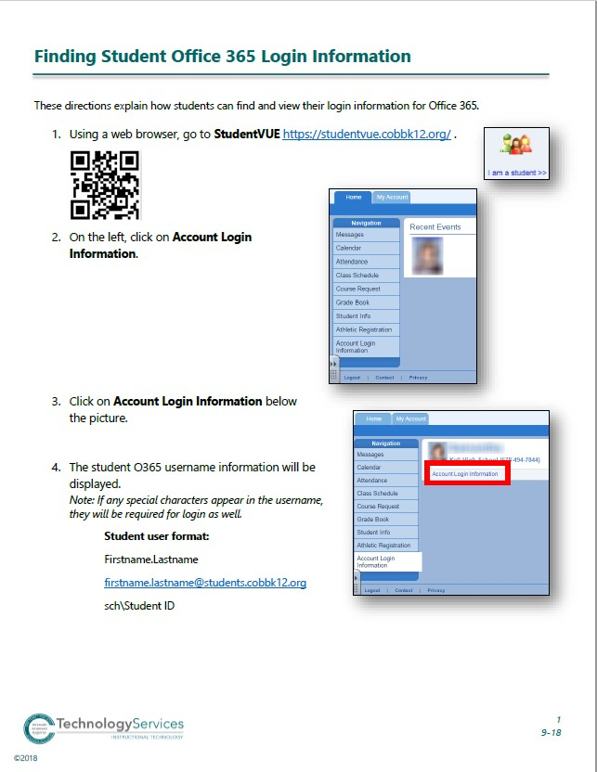

Slide 13
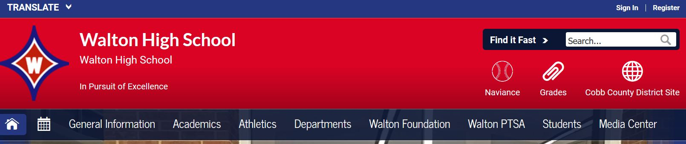
Log in to Naviance
Go to: www.WaltonHigh.org
Look in the top right corner.
Click on the ball icon that says Naviance.
Use student's Office 365 login information to access Naviance from home.

Slide 14
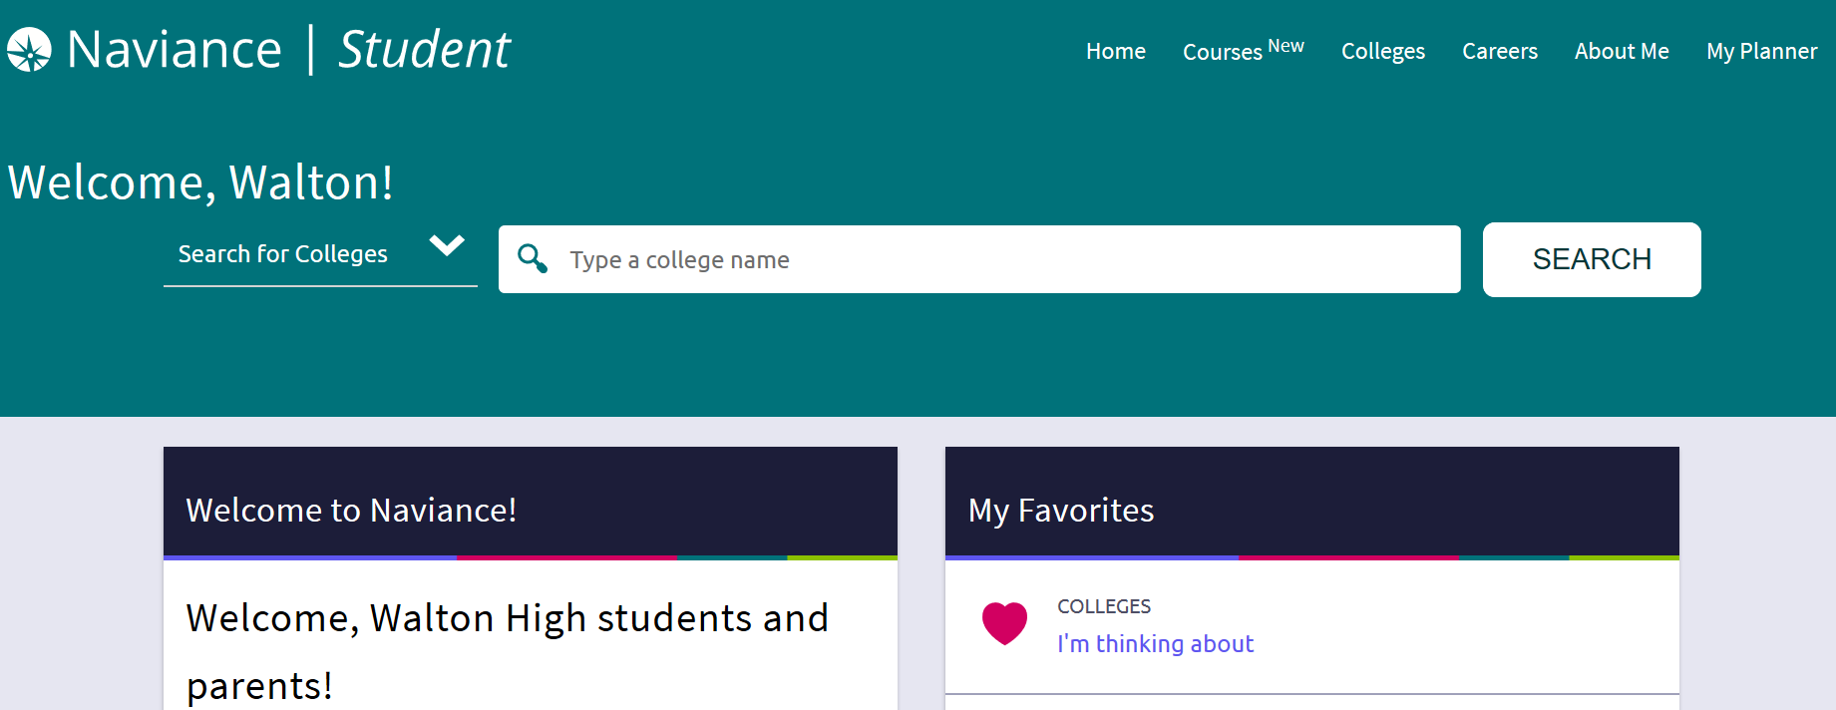
Naviance Homepage
IGP Instructional Video: https://www.loom.com/share/37972e8a4a0241ad8ddd79efb7dd1b22

